Slide 1

Mapping with Tableau
Garrett Morrow
Race, Crime, and Criminal Justice
Ramiro Martinez
Fall 2019

Slide 2
Introduction
This is an introduction, hands-on tutorial for using Tableau for basic point mapping. Students will:
Be introduced to what Tableau is.
Understand how to import and modify data in the Tableau environment.
Plot coordinate points onto a basemap.
Filter data in a variety of ways to produce custom visualizations.

Slide 3
Tableau Basics
Tableau is a powerful visualizations tools recently purchased by SalesForce. It can produce a variety of beautiful charts a graphs that look much nicer than basic Excel visualizations.
Tableau can also do basic mapping!
A Tableau license is available for free for students with a .edu email address. You can use the key on two different devices.
Link to Tableau for students: https://www.tableau.com/academic/students

Slide 4
Key Terminology
X/Y Coordinates: Numerical values that allows every location on earth to be pinpointed.
Latitude/Longitude: Latitude is the north/south coordinate of a location based upon its distance from the equator. Longitude is the west/east coordinate of a location based upon its distance from the standard meridian.
Dimension: “Qualitative values (such as names, dates, or geographical data). You can use dimensions to categorize or segment your data.”
Measure: “numeric, quantitative values that you can measure. Measures can be aggregated. When you drag a measure into the view, Tableau applies an aggregation to that measure (by default).”

Slide 5
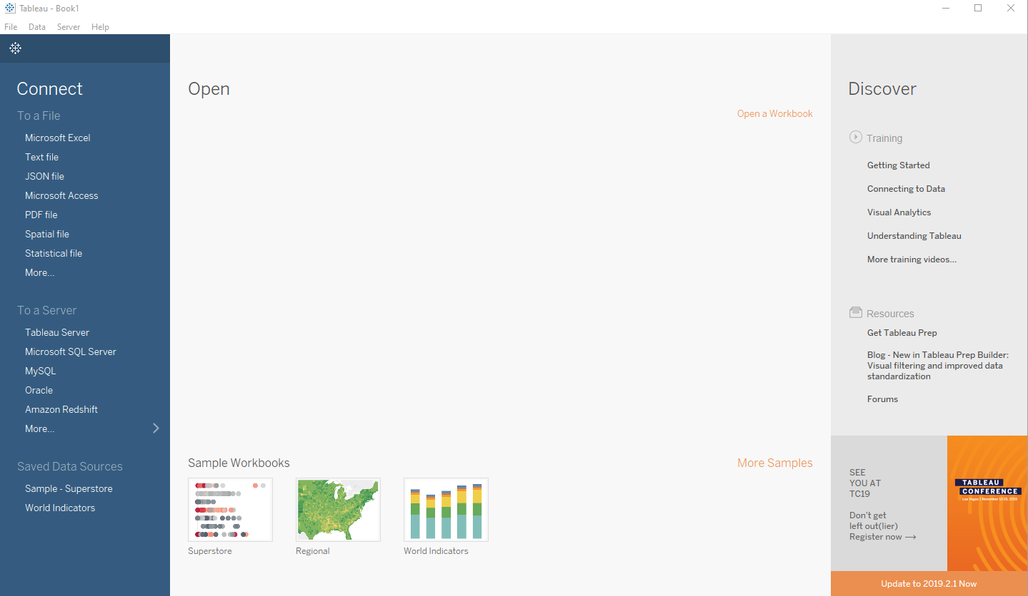
Using Tableau
Step One: Connecting to Data
First, we need to connect to our data.
For the purposes of this exercise, we will be using homicide data from Miami-Dade County in Excel format.
Select ‘Microsoft Excel’ and navigate to the data file.

Slide 6
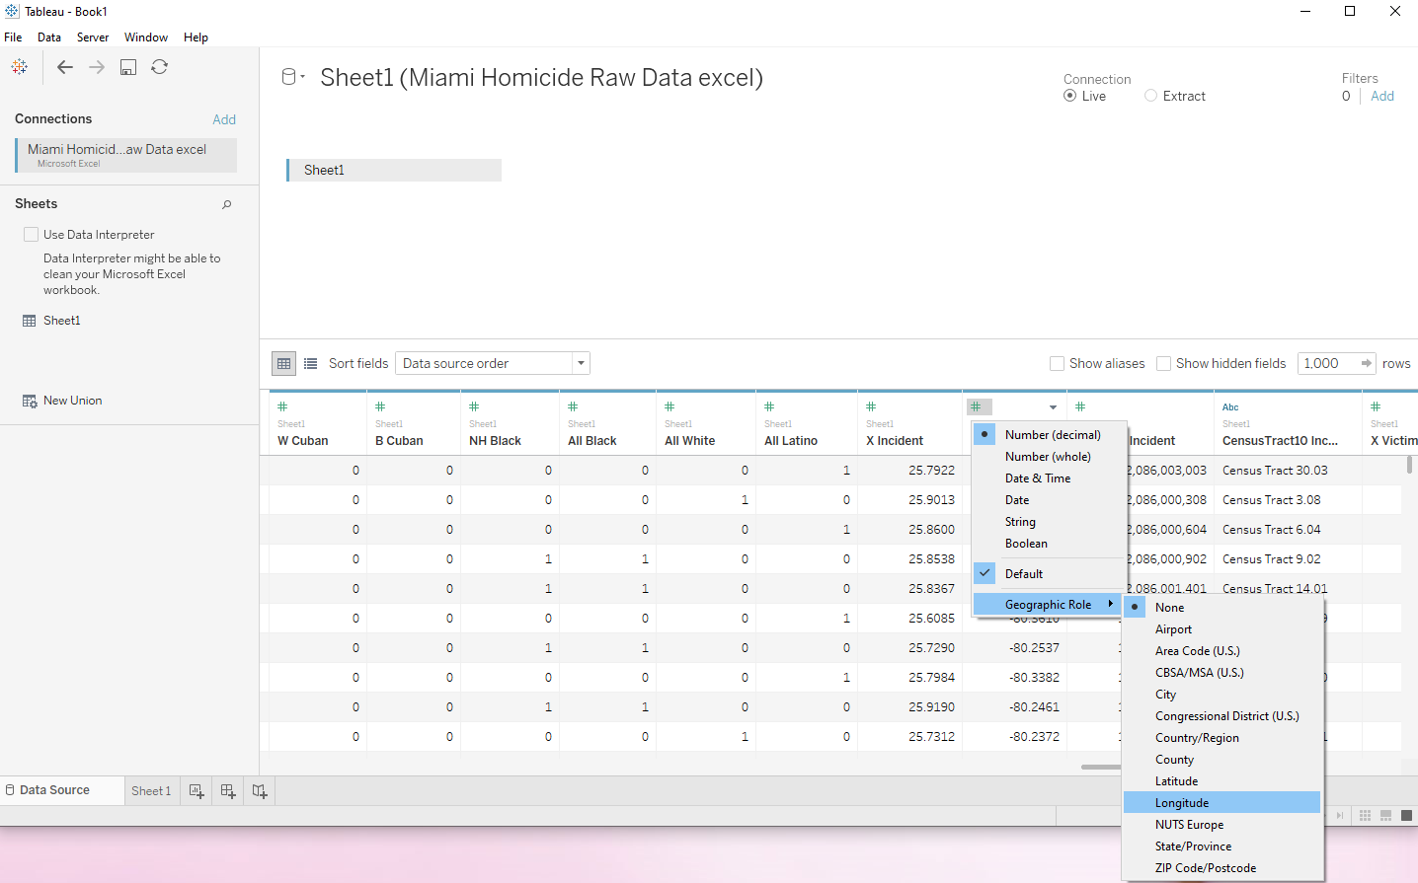
Using Tableau
Step Two: Convert Coordinate Column to Geo Data
We can change the data type of our columns by clicking on the # or Abc at the top of the column display.
In order to map our data, we have to first convert the X/Y data into a coordinate class.
We can do this by clicking on the #, hovering over ‘Geographic Role,’ and clicking on Latitude or Longitude. Convert:
X -> Latitude
Y -> Longitude

Slide 7
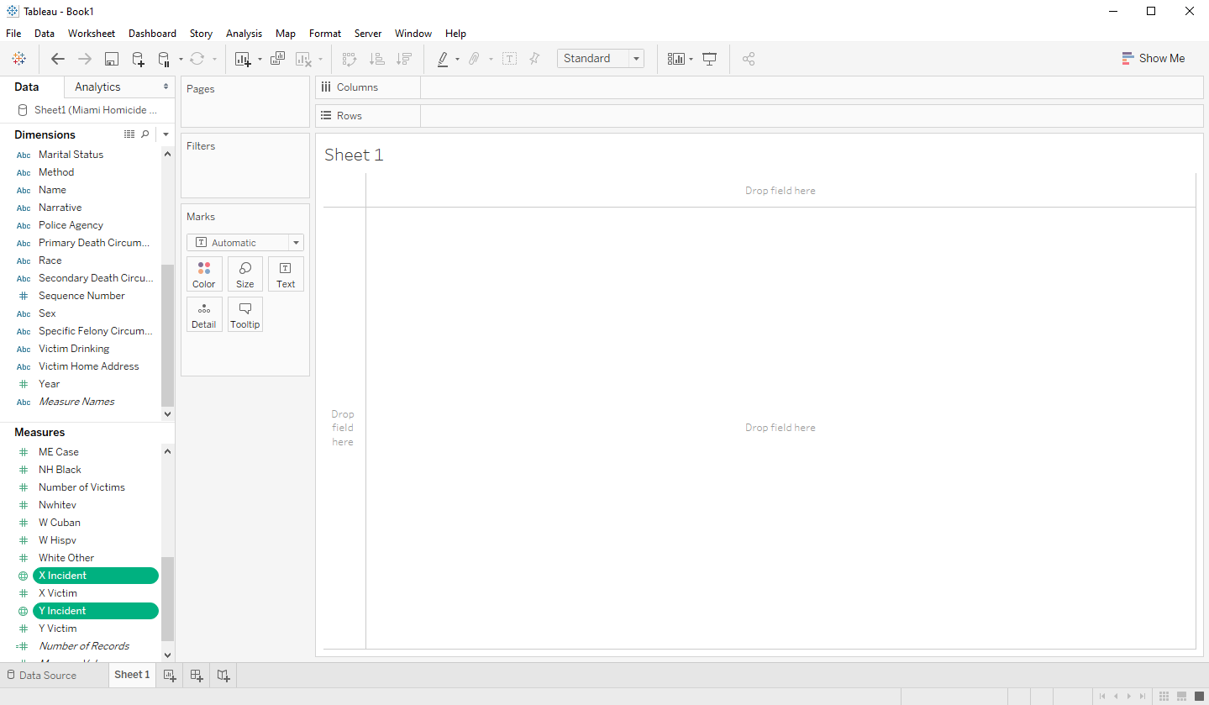
Using Tableau
Step Three: Convert our Data
First, click on Sheet 1 at the bottom of the page to move to our worksheet.
Next, we need to convert our X/Y data from a measure to a dimension. Do this by dragging and dropping our data points up from the measures box to the dimensions box.

Slide 8
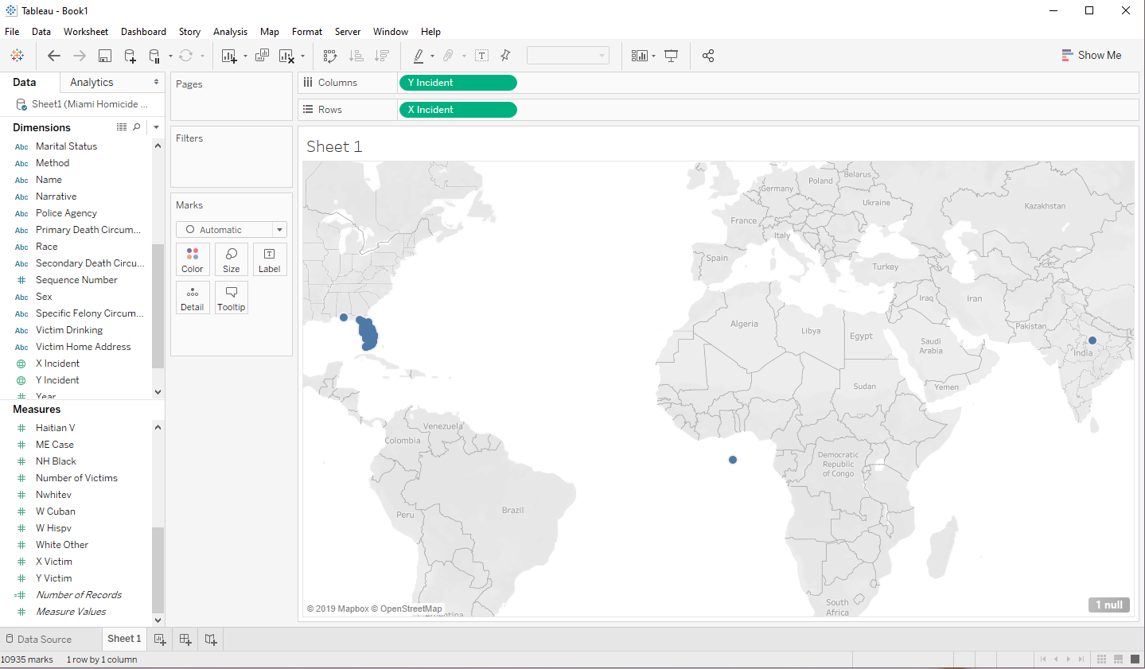
Using Tableau
Step Four: Plot our Points
To map our data points, we drag our Y data into the ‘columns’ area, and our X data in the ‘rows’ area.
Tableau will automatically plot our points based upon the X/Y coordinates.
There are stray points: one off the west coast of Africa, and another in northern India. We could fix this by filtering or cleaning our data, but we will ignore this for now.

Slide 9
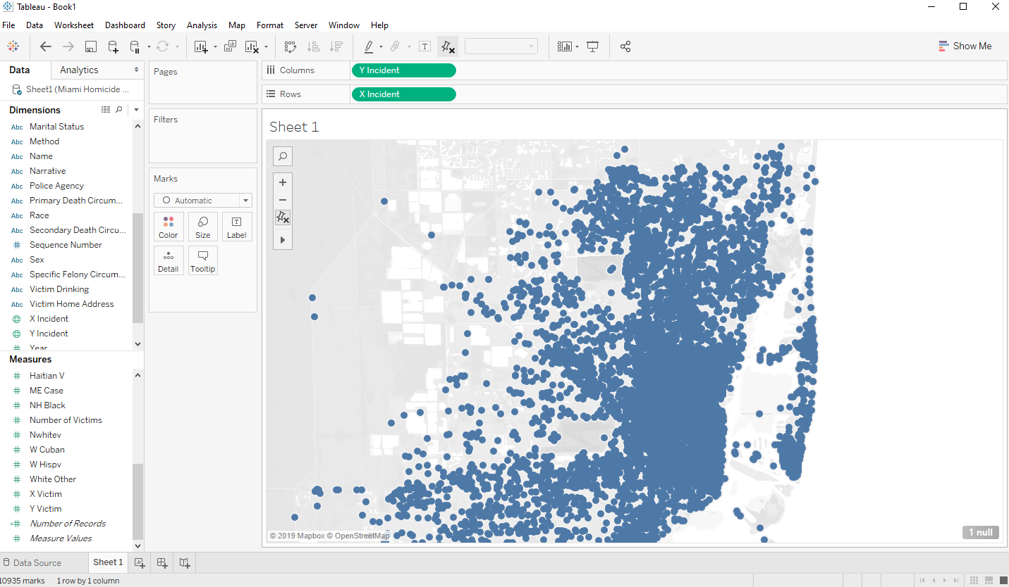
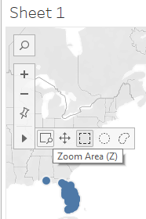
Using Tableau
Step Five: Zoom Controls
The navigation and zoom controls are in the top left of the plot area. We can use the zooming and panning tools to navigate to our area of interest.
We have zoomed into the Downtown Miami and Miami Beach areas.

Slide 10
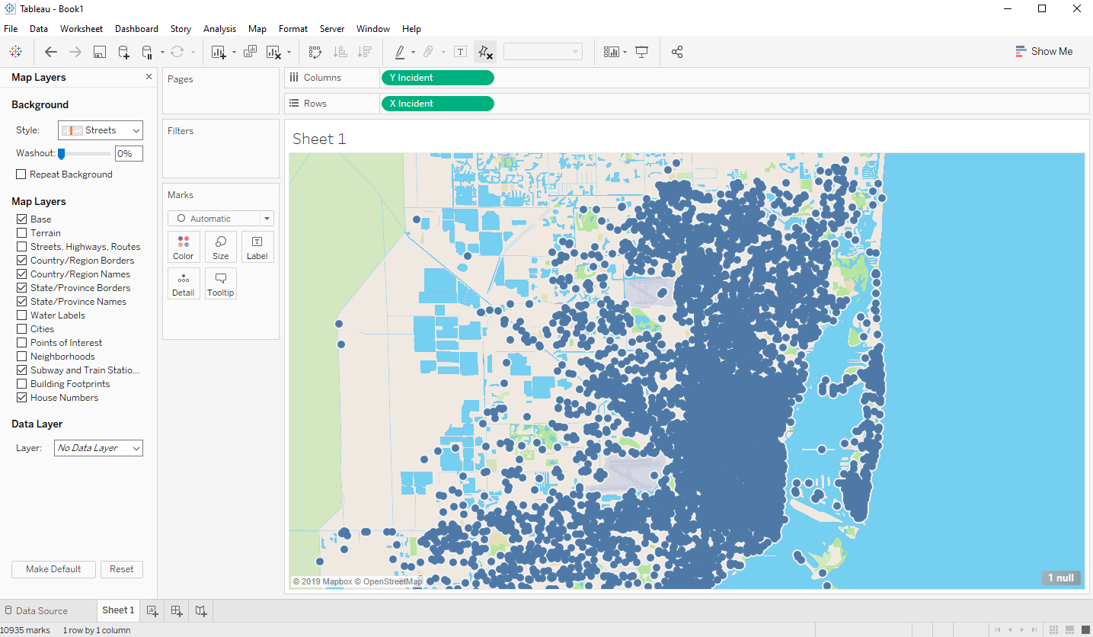
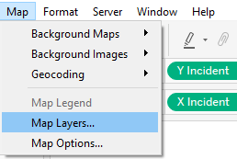
Using Tableau
Step Six: Modify Basemap
We can use the ‘Map’ > ‘Map Layers…’ option from the toolbar to modify our basemap.
We have changed our Style to ‘street.’ You may also want to toggle other Map Layers like ‘Streets, Highways, Routes.’
When you are done, click the X at the top of the map layers sidebar.

Slide 11
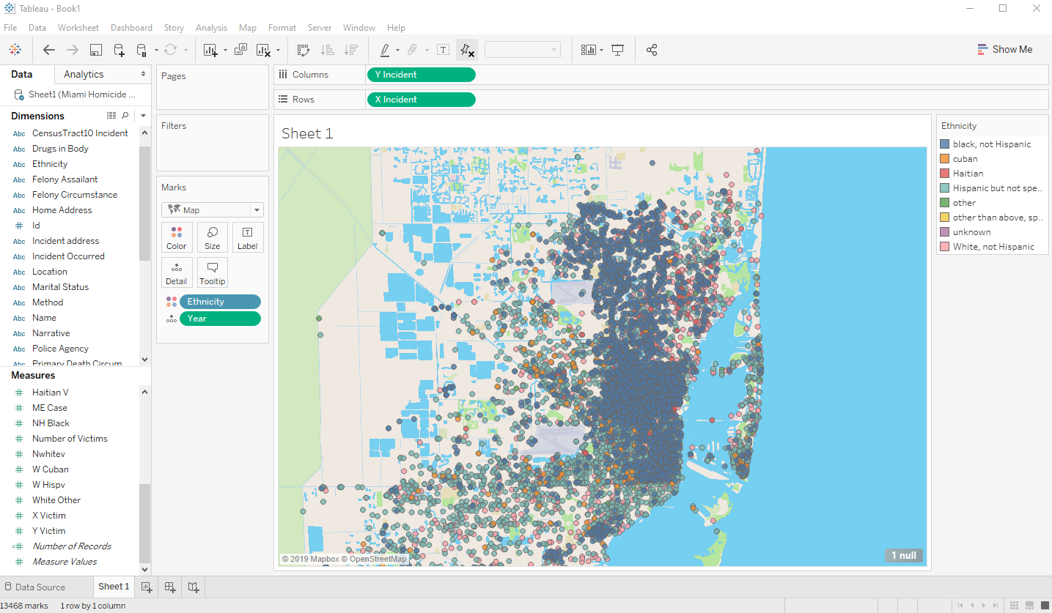
Using Tableau
Step Seven: Create Filters
To create different filters and visualization parameters, drag a dimension or measure into the ‘marks’ box.
To specify a type of visualization, drag the parameter of choice onto ‘color,’ ‘size,’ etc.
For this exercise, we have mapped ethnicity as a color, and year as a detail (which will appear as a tooltip).

Slide 12
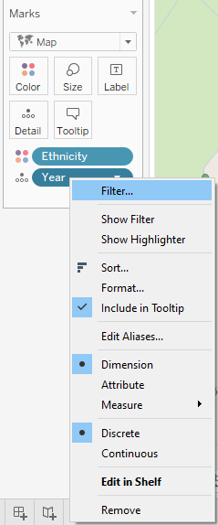
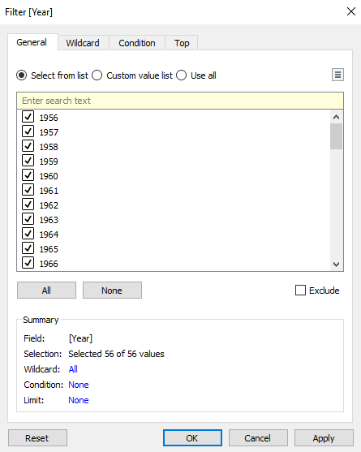
Using Tableau
Step Seven: Create Filters Continued
For this exercise, we want to filter our year data parameter to only display murders for five years, 2007-2011.
First, we converted our dates into a discrete variable.
Next, we click on ‘Filter…’ This will bring up the filter box.
Now we will deselect all and then check the boxes for the years 2007-2011.

Slide 13
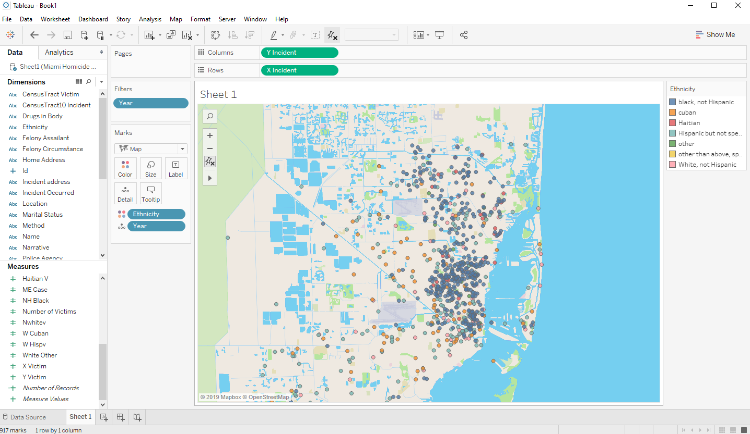
Using Tableau
Step Seven: Create Filters Results

Slide 14
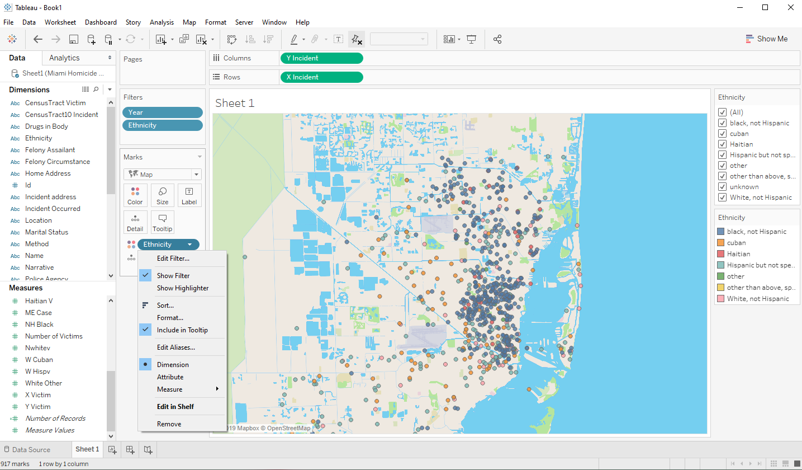
Using Tableau
Step Seven: Create Filters Continued
The next step is to filter by ethnicity.
If we click on ‘ethnicity’ in the marks panel, we can then select ‘show filter.’
Show filter will then display the filter box we used for our dates, but as a sidebar. From here we can select or deselect filter parameters.
We will only select Cuban and Haitian for this exercise.

Slide 15
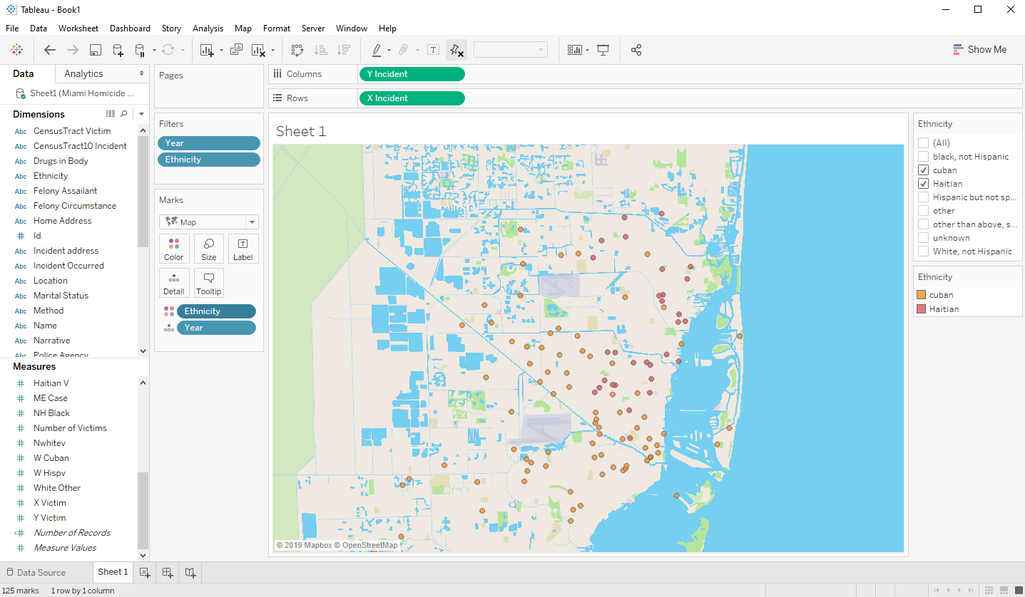
Using Tableau
Step Seven: Create Filters Results

Slide 16
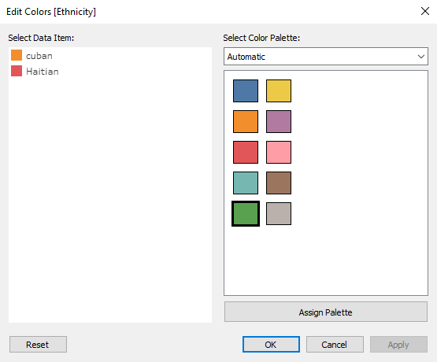
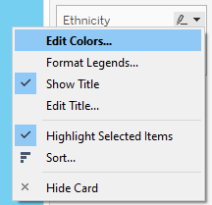
Using Tableau
Step Eight: Modify Colors
The orange and pinkish colors for Cubans and Haitians do not contrast very well, so we will now change the colors.
On the ethnicity sidebar, click the drop down arrow, then click on ‘edit colors…’
On the edit colors box we can now change our colors to contrast more for better visualization.

Slide 17
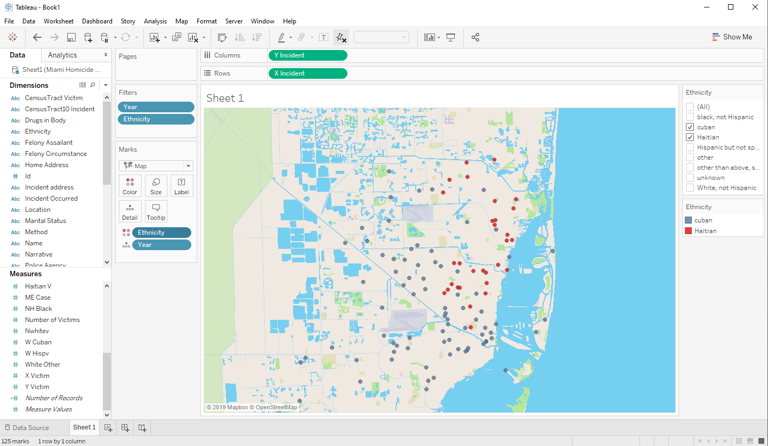
Using Tableau
Step Eight: Modify Colors Results

Slide 18
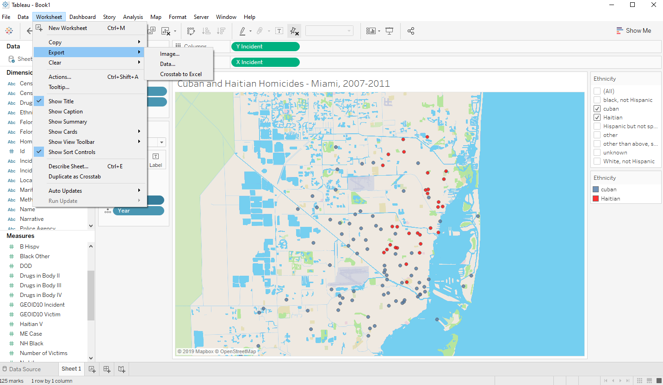
Using Tableau
Step Nine: Exporting Images
Once we are happy with our map after filtering for different data points, we can export our image.
From the ‘Worksheet’ drop-drop down menu, hover over ‘Export,’ then click on ‘Image…’ You can think select the type of export then click ‘save.’
Navigate to where you would like to save the image, name it, and change the file type if you would like - then click save.

Slide 19
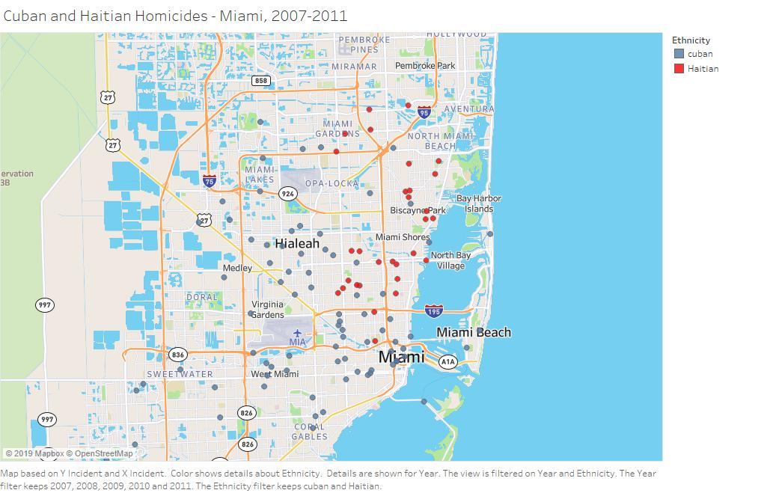

Slide 20
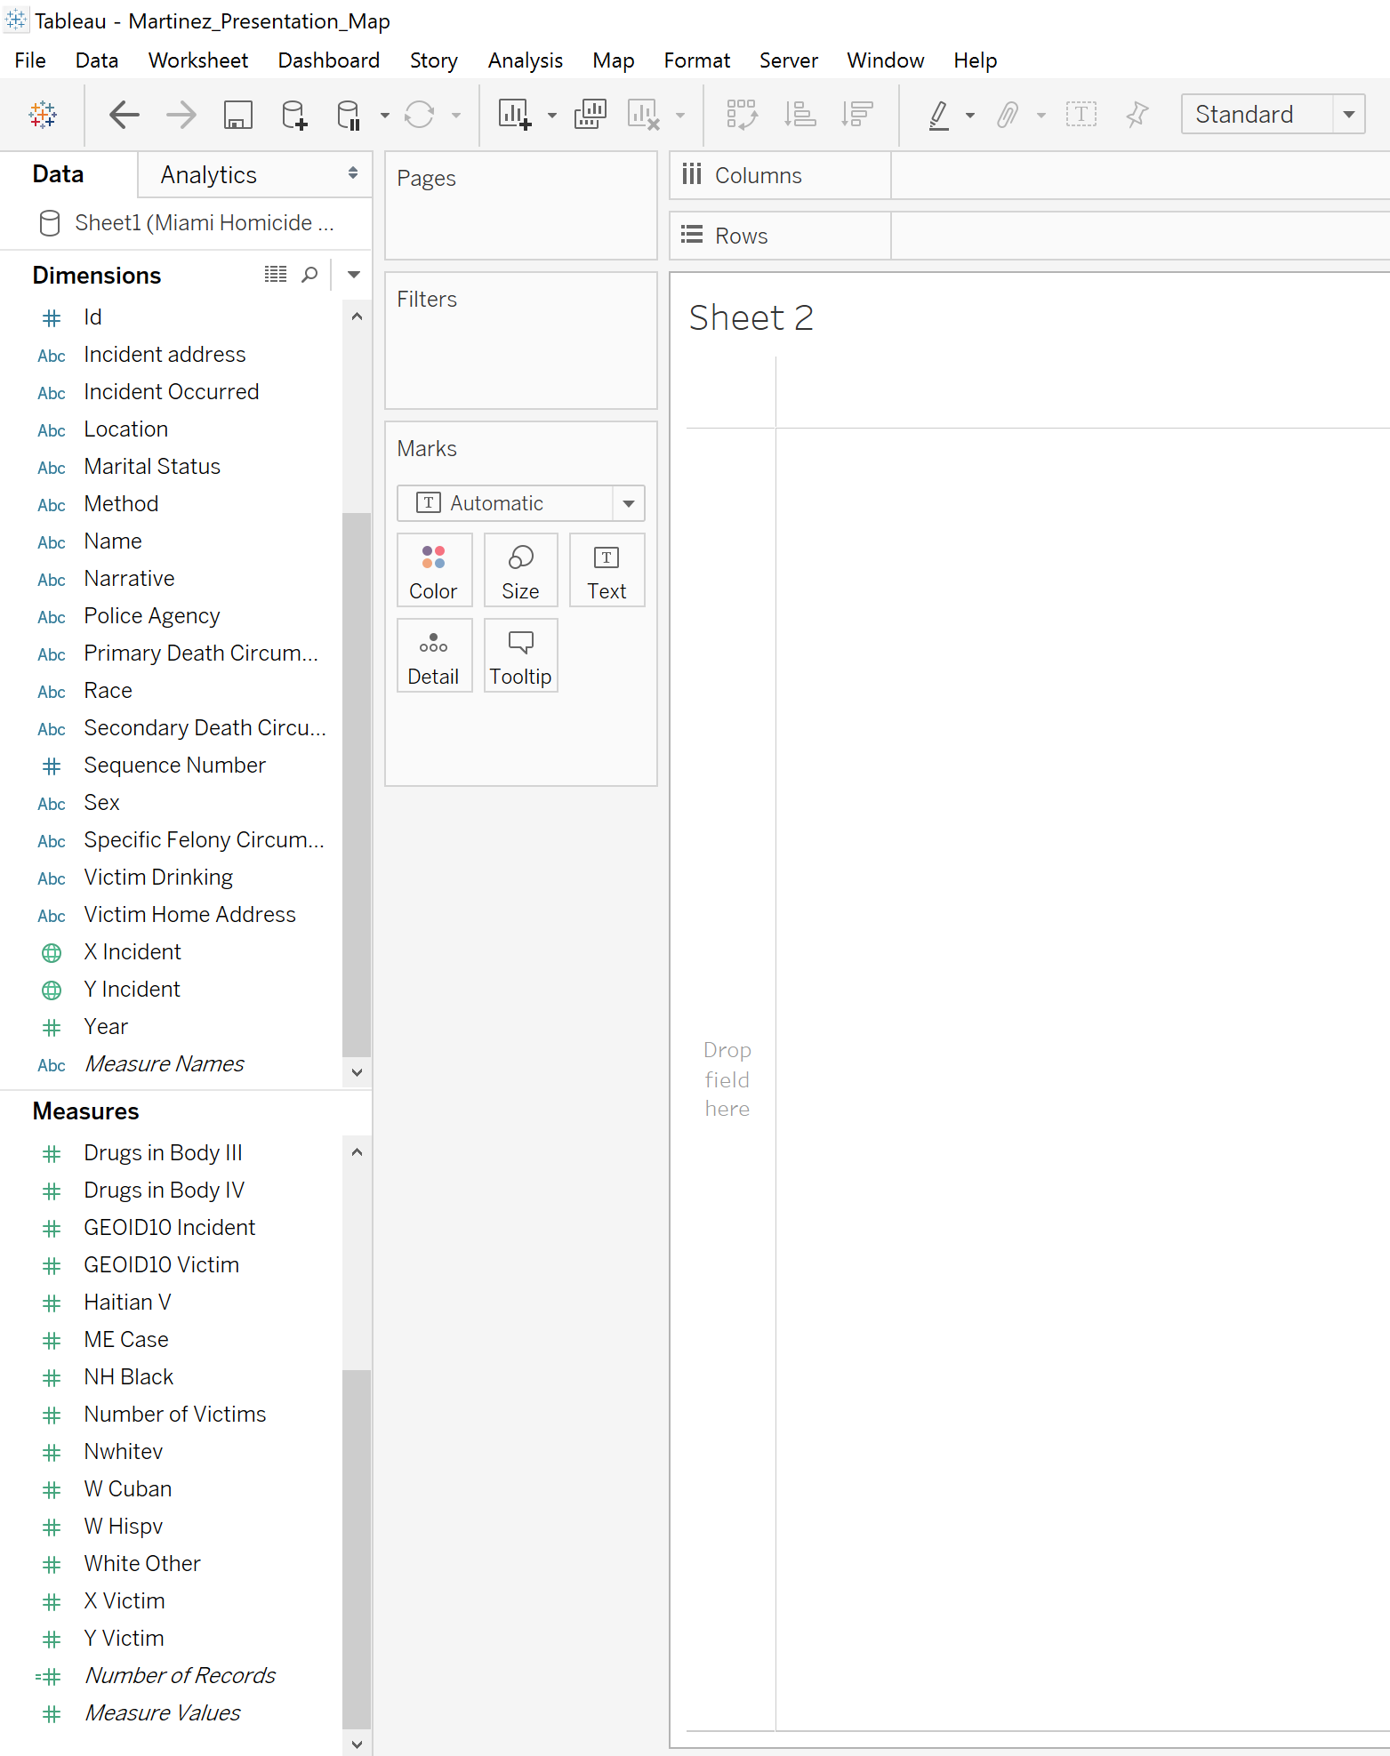
Graphs with Tableau: Drag & Drop
Similar to mapping, creating a graph is as simple as dragging and dropping our dimensions and measures.
In this demonstration, we will map the number of records over time according to ethnicity.
First, we will drag and drop our ‘Year’ dimension to the columns, and the ‘Number of Records measure to the rows.

Slide 21
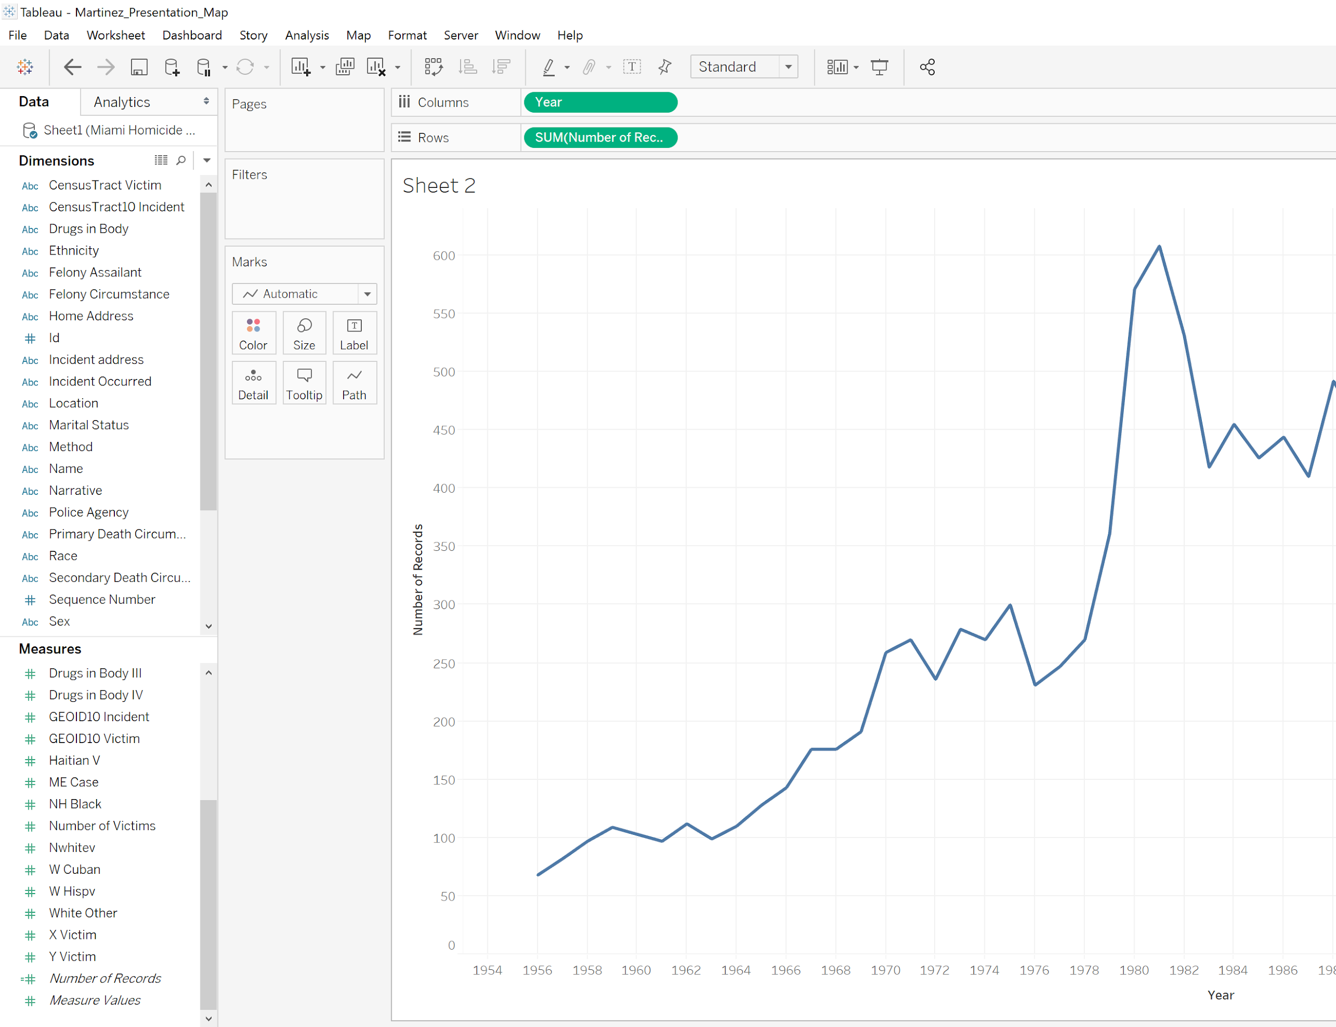
Graphs with Tableau: Drag & Drop
We now have a graph of records over time, but we still need to show specific ethnicities over time.
Next, we drag and drop our “Ethnicity” measure onto colors in the marks box to the left of our new graph.
Tableau will automatically set each ethnicity to a different color and redraw our graph.
We will then export the graph in the same way we exported our map.

Slide 22
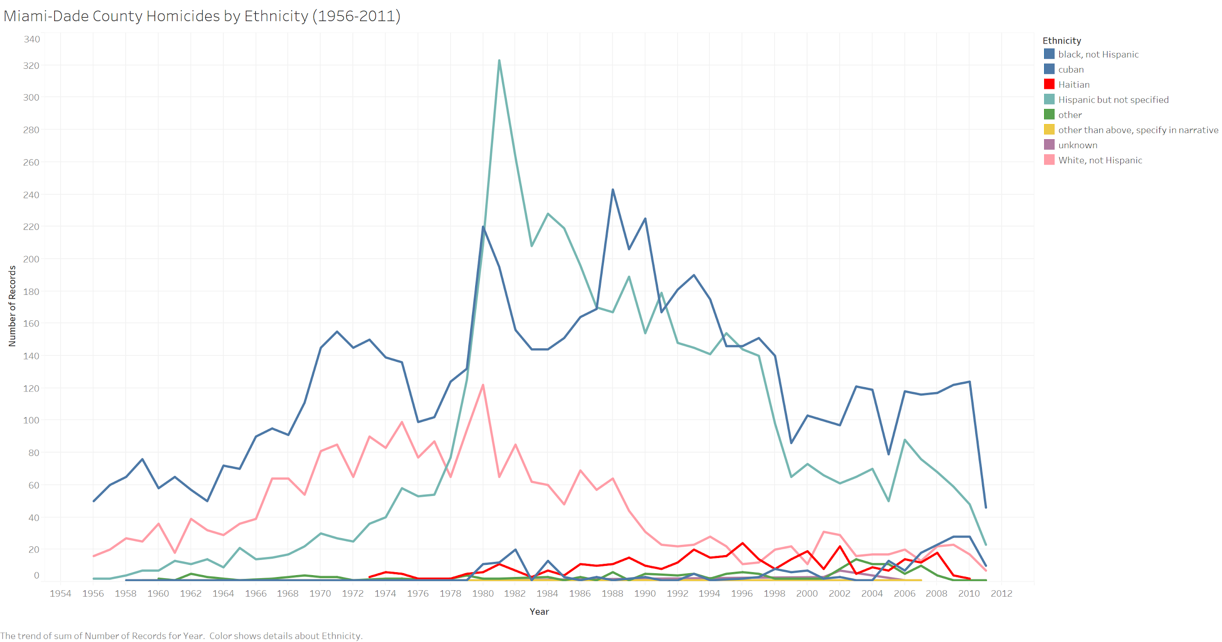

Slide 23
Example Research Questions
What is the spatial relationship between gun and non-gun crimes?
Are there any spatial patterns for homicides of people with drugs in their body at the time of the incident?
Are there any spatial patterns of death circumstance?
What does the homicide data say about historical events (e.g., the Mariel Boatlift of 1980)?
Which census tracts have the most homicides?

Slide 24
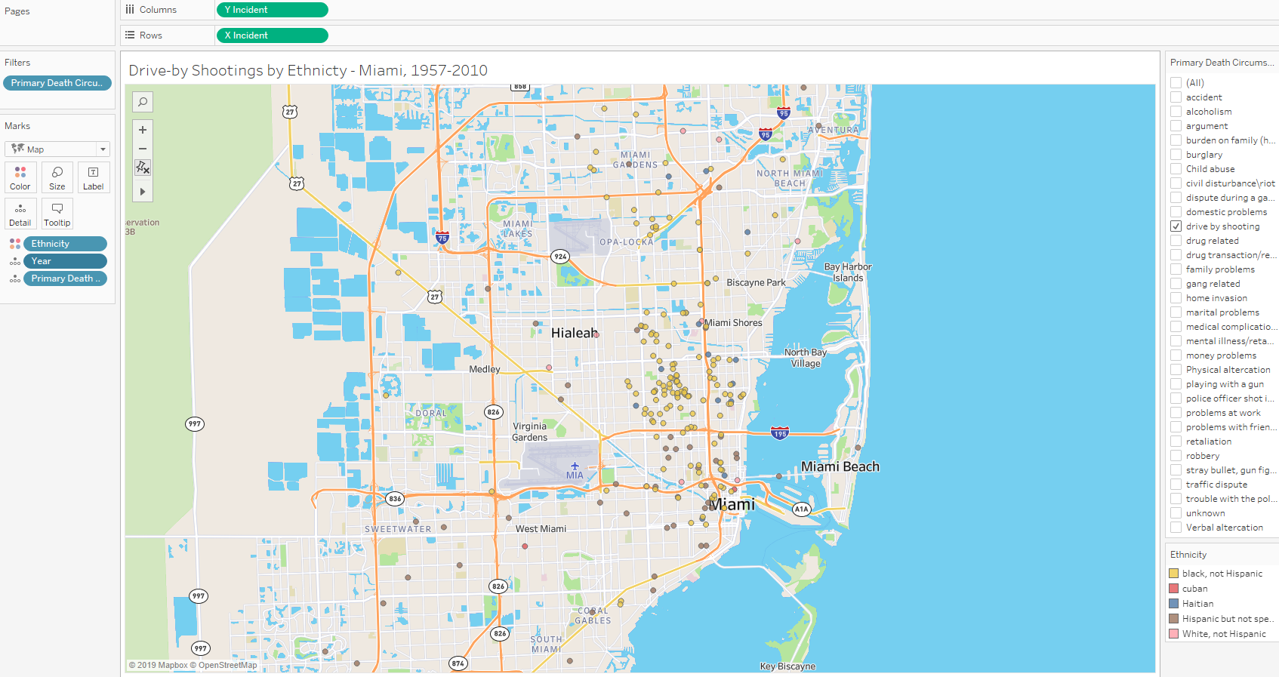

Slide 25
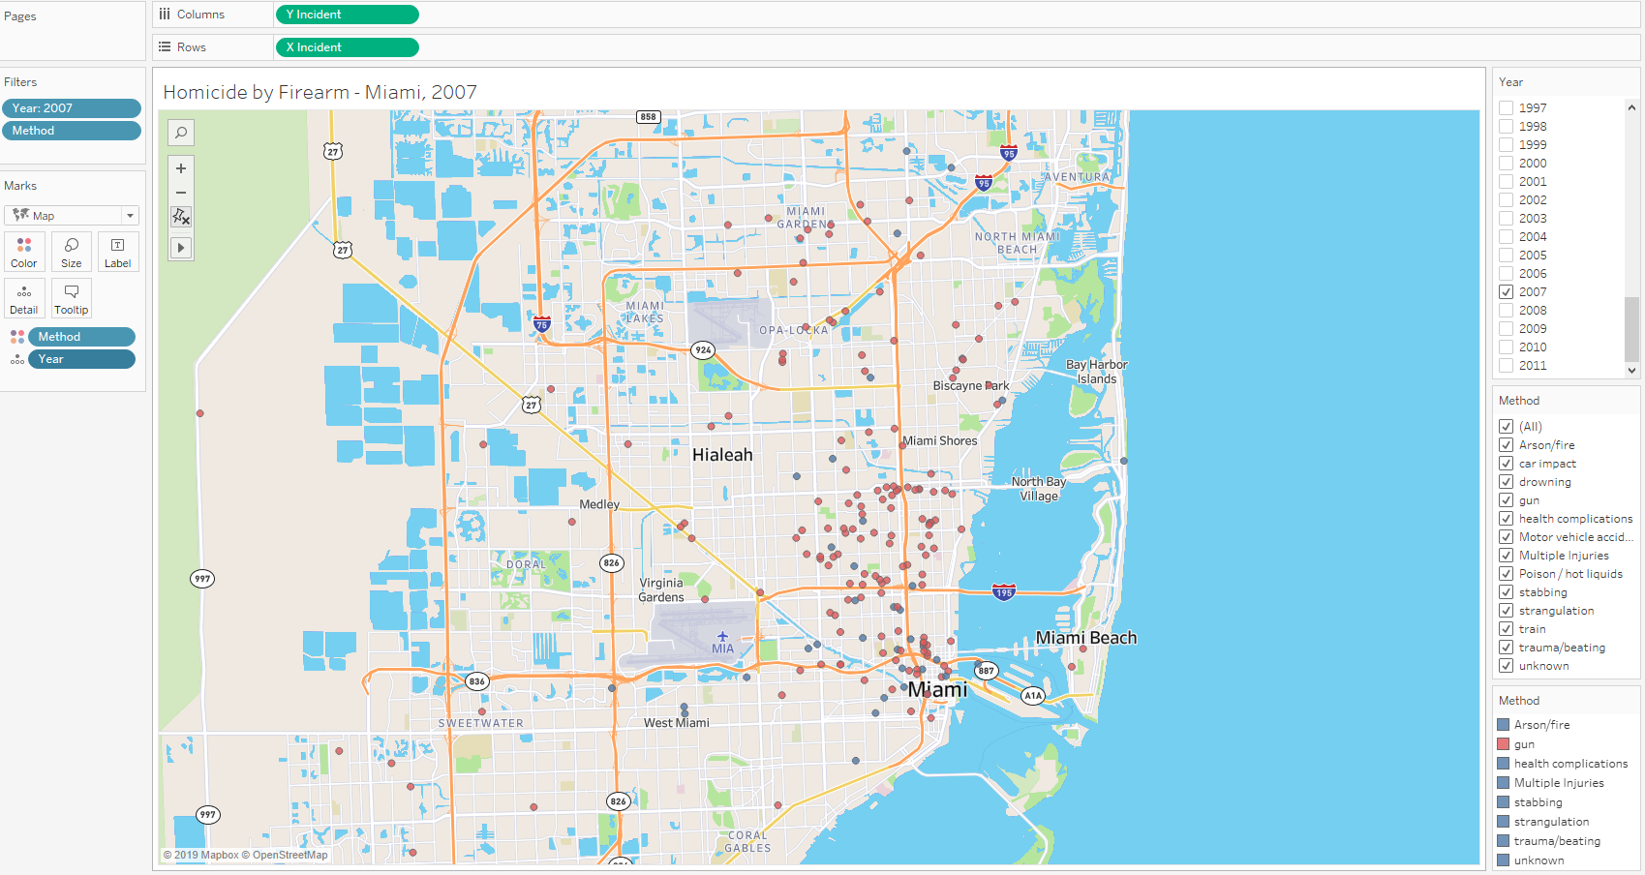

Slide 26
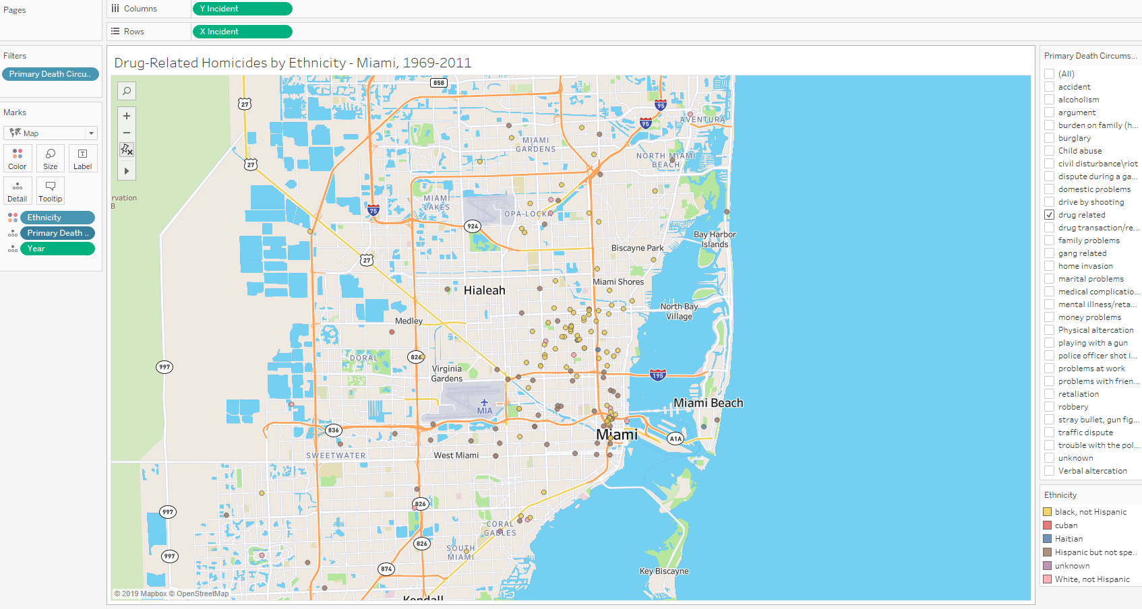

Slide 27
Conclusion
Tableau is a powerful tool for quickly mapping coordinate points onto a simple map. Experiment with the many different options available for filtering data and displaying data in different ways.
Tableau is also very powerful at creating a variety of charts and graphs, this can easily be done by dragging non-coordinates to the ‘column’ and ‘row’ areas.
Research questions can include a number of different dimensions and measures - do not be afraid of experimenting with different visualizations
For more powerful mapping software, see ArcGIS, QGIS, or CartoDB.

Slide 28
Questions & Contact Information
Garrett Morrow
Digital Teaching Integration Research Fellow
PhD Student, Political Science
morrow.g@husky.neu.edu

